Slide 1
Genetic Programming
Vishal Yelisetti
Ou Li
SEIS 610
5/9/15

Slide 2
Agenda
Demo
Requirements Analysis
Design - OOO (Reason)
Testing
Post-Project Analysis
Learn and Summary

Slide 3
Demo Time
Characteristics
Time
Function Tracing

Slide 4
Requirements
Client
Client Requirement
User Interface
Target Client
Data
Data Modes
Data Collecting
Setting Collecting
Function Set
Function

Slide 5
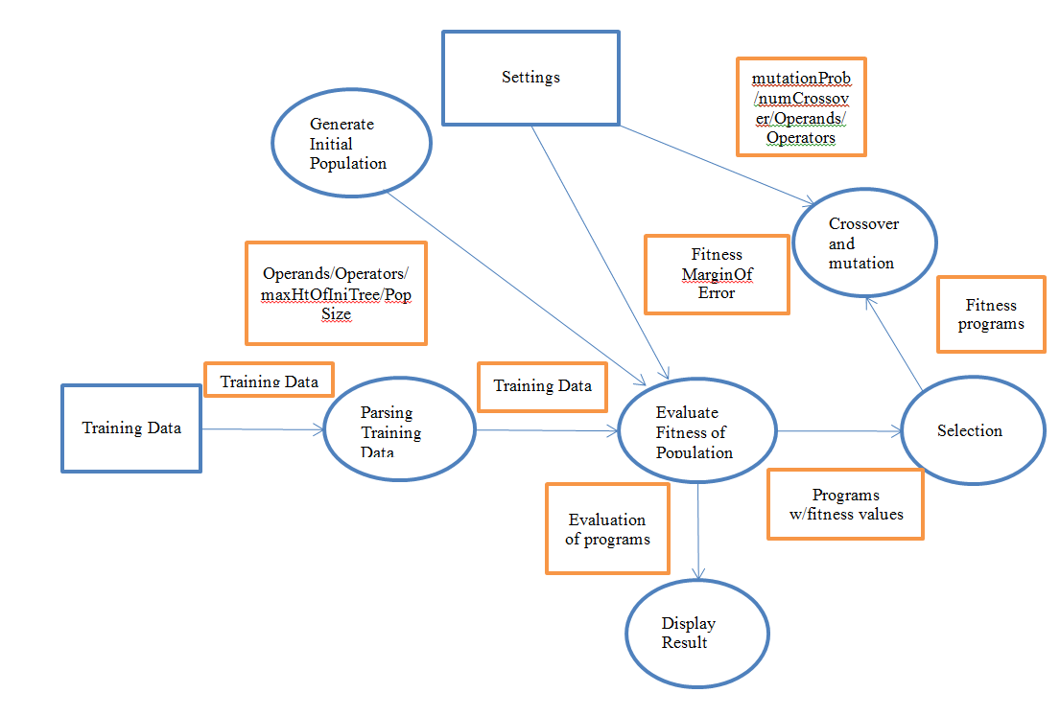

Slide 6
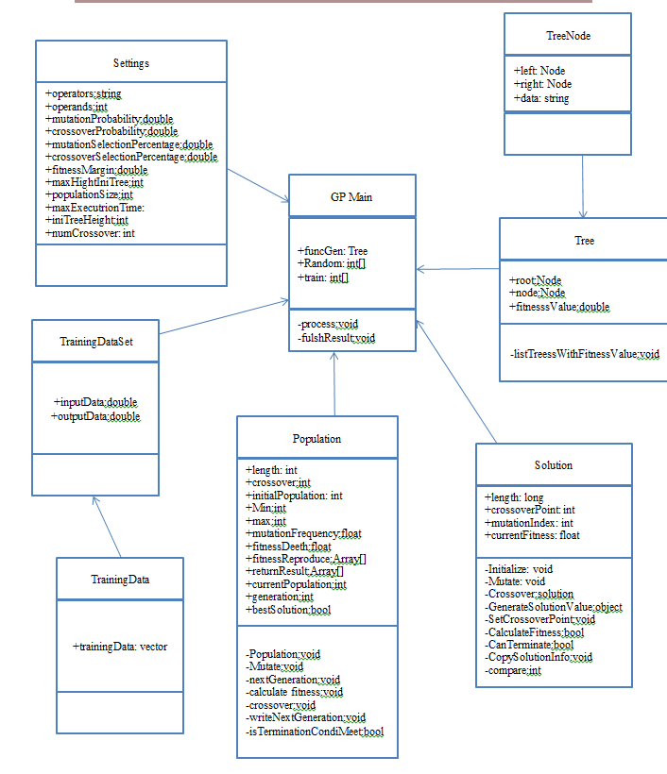
OO Analysis

Slide 7
Reasons in Selecting Object Oriented Approach
Graphical Interface is much easier to do
Low-risk, high reward – stable systems
Easier to decipher bugs
Examples
Python
.NET
C++/C

Slide 8
Testing
Metrics
CC/WMC
LOC
Coupling Factor
MOOD Metrics
Test Coverage
White box Test Cases
Black-Box Test Cases
Github Graphs
Figure 2 – Overall System Metrics

Slide 9
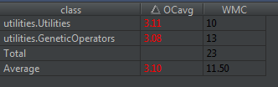
CC and WMC
Figure 1 – CC metrics for troubled classes

Slide 10
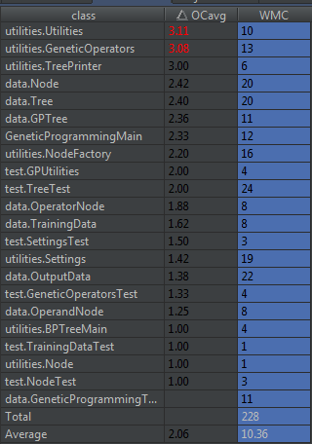
Overall Cyclomatic Complexity

Slide 11
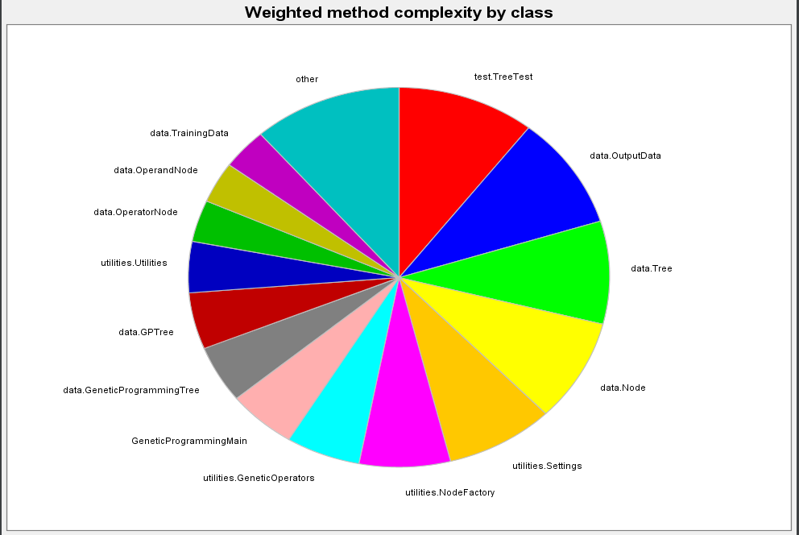

Slide 12
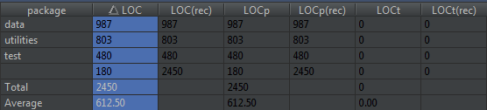
LOC
Figure 2 – Lines of Code (Package Metrics)

Slide 13
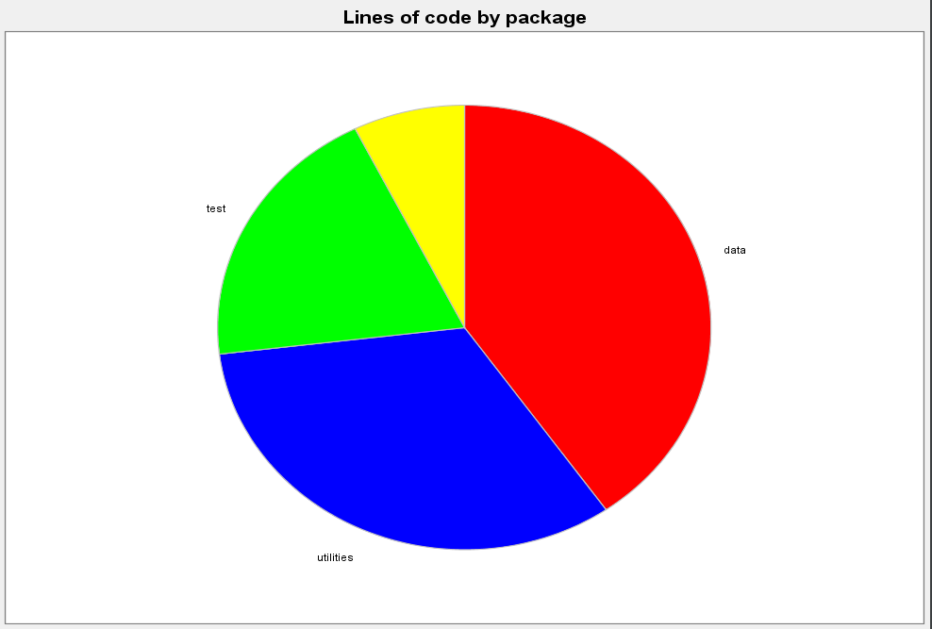

Slide 14
MOOD Metrics
Figure 3 – Mood Metrics

Slide 15
Sample Test Cases – White box
Name: Sorting_Test
Expected Output: Ascending order of trees in a sorted manner
Pass/Fail
Name: Tree_Test
Expected Output: Output an array size greater than 1
Pass/Fail

Slide 16
Sample Test Cases – Black Box
Name: Overall_time_completion
Expected Output: System shall display the needed function in less than the “max-time” limit
Pass/Fail
Name: Real-Time_functional_analysis
Expected Output: System shall display the graphical user interface for the outputted result real-time
Pass/Fail

Slide 17
Testing Databases
IntelliJ Metrics plug-in
JHawk Eclipse plug-in
Matlab

Slide 18
SCM
Milestone Estimated Completion Date
Phase I: Requirement Analysis------------------------------------------- 2/15/2015
Phase II: Design--------------------------------------------------------------- 3/08/2015
Phase III: Implementation------------------------------------------------- 4/14/2015
Phase IV: Testing-------------------------------------------------------------- 4/25/2015
Phase IV: Final Report Review-------------------------------------------- 5/03/2015
Phase IIV: Presenting/Release-------------------------------------------- 5/9/2015

Slide 19
Learned and Summary
Learned
Software Engineering Models
Testing Methods
Measurements
Time Management
Documentation
Summary
Design and Implementation
Tools

Slide 20

Discussion

Slide 21
Annotated Bibliography
Information used requirement analysis
Software Engineering Theory and Practice, Fourth Edition
Author: Shari Lawrence Pfleeger, Joanne M. Atlee
Information used for the design and development of the genetic operators.
The GP Tutorial. (1996-2013). [Online]. Available: http://www.geneticprogramming.com/Tutorial/
Information used for the design and development of the genetic operators.
Kevin Dolan. (2009). "Selection." Genetic Programming Source. [Online]. Available:
http://geneticprogramming.us/Selection.html
Information used for the design and development of the genetic operators.
The Java Tutorial. (19995-2013). Lesson: Algorithms. [Online]. Available:
http://docs.oracle.com/javase/tutorial/collections/algorithms/#sorting
Information about Java Metrics
Aivosto, and Thomas Salste. “Aivosto” -Programming Tools for Software
Developers.” Aivosto. N.p., 1997. Web. 08 May 2015
Information about Generic Programming Environment
GitRepo: https://github.com/jnaithani/genetic-programming
Mohammed Alsaihati and others, Sept 2013

